Slide 1
WORD AND SENTENCE STRESS

Slide 2
STRESS:
Stress refers to the relative emphasis that may be given to a syllable in a word or a word(s) in a sentence. It is important because it highlights the message carrier words in a sentence.
There are two kinds of stress
Word Stress refers to a particular syllable (or parts of words) stressed within an overall word.
Sentence Stress refers to the process whereby particular words are stressed within an overall sentence.

Slide 3
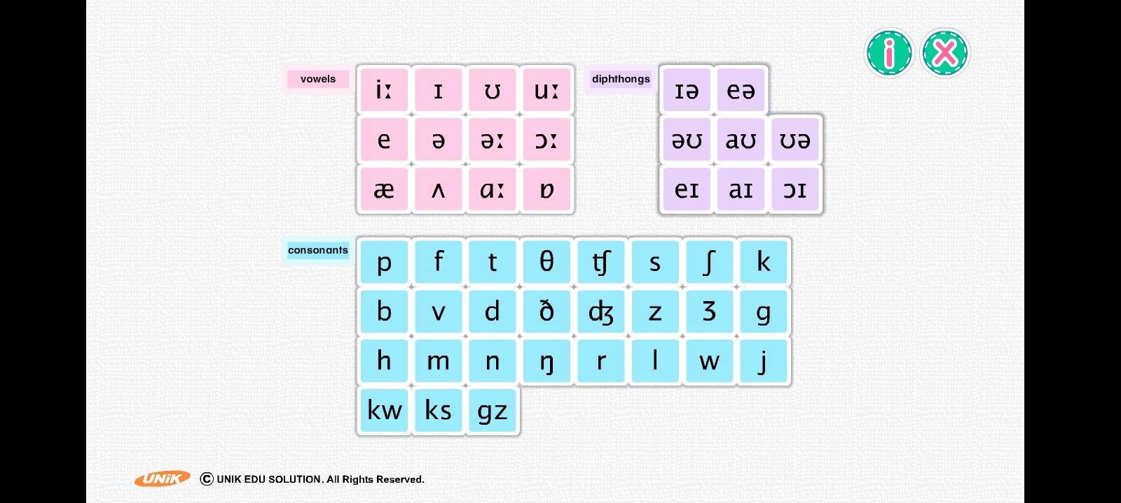
Review: Vowel sounds and consonant sounds

Slide 4
How to pronounce word stress?
When a syllable is stressed, it is pronounced:
longer in duration
higher in pitch
louder in volume

Slide 5
Syllables.
What is a syllable?
A syllable is the sound of a vowel (A, E, I, O, U) that is created when pronouncing the letters A, E, I, O, U, or Y.
The letter "Y" is a vowel only if it creates an A, E, I, O, or U sound.
examples: fry, try, cry, & dry
The number of times that you hear the sound of a vowel is the number of syllables in a word
When two (or more) vowels are next to each other, the number of syllables depends on the number of vowel sounds.
examples: free (1 syllable), eat (1 syllable), & bio (2 syllables)
If a vowel is silent, it is not counted as a syllable.
example: fire (1 syllable)
Does the word end with "le" or "les?" This is a syllable if the letter before the "le" is a consonant.

Slide 6
How do you say teacher?
Longer | teeeeeeeeeeee cher
Higher | tea
 |  | cher
Louder | TEA cher
All three combined | TEEEEEEEEEEE
 |  |  | cher

Slide 7
Word Stress Rules
There are two very simple rules about word stress:
One word has only one stress. (One word cannot have two stresses.
We can only stress vowels, not consonants.
It`s because syllables are vowel sounds with or without consonant sounds.
With many exceptions Here are some more, rather complicated, rules that can help you understand where to put the stress.

Slide 8
Word Stress Rule
Word type |  | Where is the stress? | Examples
Two syllables | Nouns | on the first syllable | center object flower
 | Verbs | on the last syllable | release admit arrange
Compound (words with two parts) | Nouns (N + N) (Adj. + N) | on the first part | desktop pencil case bookshelf greenhouse
 | Adjectives | on the last part the last/verb part | well-meant hard-headed old-fashioned
 | Verbs (prep. + verb) |  | understand overlook outperform

Slide 9
There are many two-syllable words in English whose meaning and class change with a change in stress.
The word present, for example is a two-syllable word. If we stress the first syllable, it is a noun (gift) or an adjective (opposite of absent). But if we stress the second syllable, it becomes a verb (to offer).
More examples:
the words export, import, contract and object can all be nouns or verbs depending on whether the stress is on the first or second syllable.

Slide 10
Word Stress Rule
Word type |  | Where is the stress? | Examples
Phrasal Verbs |  | on the particle (last part) | turn off buckle up hand out
Word with added ending | -ic | The syllable before the ending (penultimate = second from end) | economic Geometric electrical
 | -tion, -cian, -sion |  | Technician graduation cohesion
 | -phy, -gy, -try, -cy, -fy, -al | the third from the last syllable (ante-penultimate = third from end) | Photography biology geometry
 | -meter |  | Parameter Thermometer barometer

Slide 11
Sentence Stress in English
Sentence stress is the music of spoken English. Like word stress, sentence stress can help you to understand spoken English, especially when spoken fast.
Sentence stress is what gives English its rhythm or "beat". You remember that word stress is accent on one syllable within a word. Sentence stress is accent on certain words within a sentence.

Slide 12
Two kinds of words in a sentence: examples on page 135
1. Content words: stressed words.
They are the stressed words that carry the meaning or the sense behind the sentence.
Content Words include: (Main) Verbs, Nouns, Adjectives, Adverbs, Negative Auxiliary Verbs, Demonstratives, Question Words
2. Function words:
Words that have more of a grammatical significance – they help the sentence “function” syntactically.
Function Words include: Pronouns, Prepositions, Articles, Conjunctions, Auxiliary Verbs, (Main) Verb “to be”

Slide 13
REMEMBER, STRESS IS ALWAYS ON CONTENT WORDS.
Content Words- STRESSED |  | Function Words- UNSTRESSED
Main Verbs | go, talk, writing | Pronouns | I, you, he ,they
Nouns | student, desk | Prepositions | on, under, with
Adjectives | big, clever | Articles | the, a, some
Adverbs | quickly, loudly | Conjunctions | but, and, so
Negative Aux. Verbs | can’t, don’t, aren’t | Auxiliary Verbs | can, should, must
Demonstratives | this, that, those | Verb “to be” | is, was, am
Question Words | who, which, where

Slide 14
If you remove the Function words from a sentence, you will probably still understand the sentence.
Add function words to complete the following sentences.
 |  | SELL |  | CAR |  |  | GONE |  | FRANCE
 |  | SELL | my | CAR |  | I’ve | GONE | to | FRANCE
Will | you | SELL | my | CAR | because | I’ve | GONE | to | FRANCE
The new words do not really add any more information. But they make the message more correct grammatically. The information is basically the same.

Slide 15
Example:
I've 'heard that 'Jack and 'Jane 'spent their 'holidays in 'Jamaica.
In the sentence above, the content words ( heard, Jack, Jane, spent, holidays, and Jamaica) are stressed (strong) whereas the function words ( I, have, that, and, their and in) are normally unstressed (weak).

Slide 16
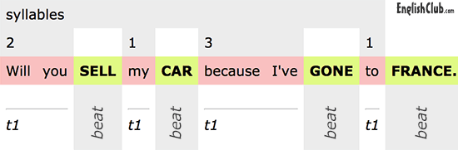
The TIME between each stressed word is the same.
In our sentence, there is 1 syllable between SELL and CAR and 3 syllables between CAR and GONE. But the time (t) between SELL and CAR and between CAR and GONE is the same. We maintain a constant beat on the stressed words. To do this, we say "my" more slowly, and "because I've" more quickly. We change the speed of the small structure words so that the rhythm of the key content words stays the same.

Slide 17
Say the following sentence in 4 different ways:
I think you’re right
Choose how you say it:
• General agreement
• I agree with you, but not with other people
• I agree, but I still have doubts
• I agree with you even if others don’t

Slide 18
I think you’re RIGHT General agreement
I think YOU’RE right I agree with you, but not with other people
I THINK you’re right I agree, but I still have doubts
I think you’re right I agree with you even if others don’t

Slide 19
TIME and rhythm.
I am a proFESsional phoTOgrapher whose MAIN INterest is to TAKE SPEcial, BLACK and WHITE PHOtographs that exHIBit ABstract MEANings in their photoGRAPHic STRUCture.

Slide 20
Watch the video and make notes of important points.
After watching the video, follow the given link and solve the quiz for word stress and sentence stress.
https://www.oxfordonlineenglish.com/syllables-and-stress

Slide 21
Homographs
Homographs are words with the same spelling but having more than one meaning. Homographs may be pronounced the same (homonyms), or they may be pronounced differently (heteronyms, also known as heterophones).
Noun
CONflict
DEfect
EXport
EXtract
PERmit
PROtest
REcord
Verb
conFLICT
DeFECT
exPORT
exTRACT
perMIT
proTEST
reCORD

